Slide 1

Student Data Analysis
Lin Yuan

Slide 2
Content
Students family status
Behavior data analysis
Which type of data affect final grades more

Slide 3
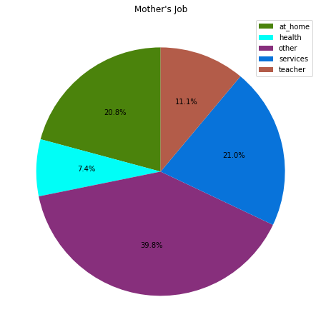
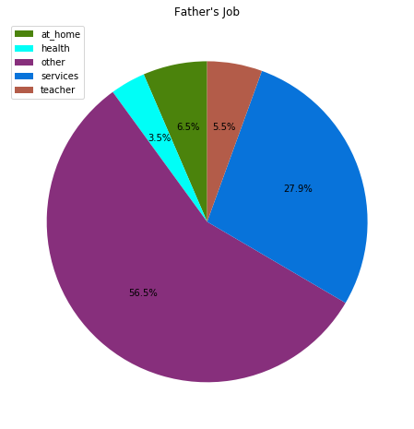
Parents' job and education status
Mothers are more
likely to be teacher
or at home, compared
with fathers’ job

Slide 4
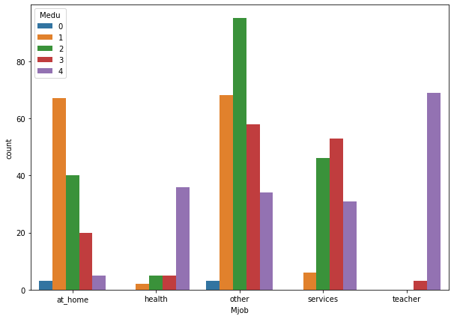
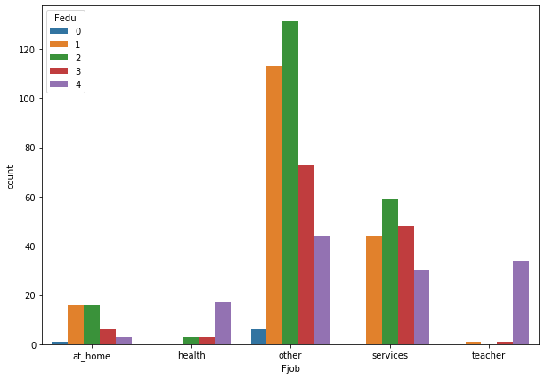
Parents' job and education status
Teacher jobs normally need highest education
Many mothers with lower education are not working

Slide 5
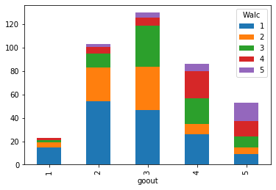
Alcohol consumption and goout
Students who go out more will consume more alcohol.
Most students will go out sometimes at weekend and consume alcohols

Slide 6
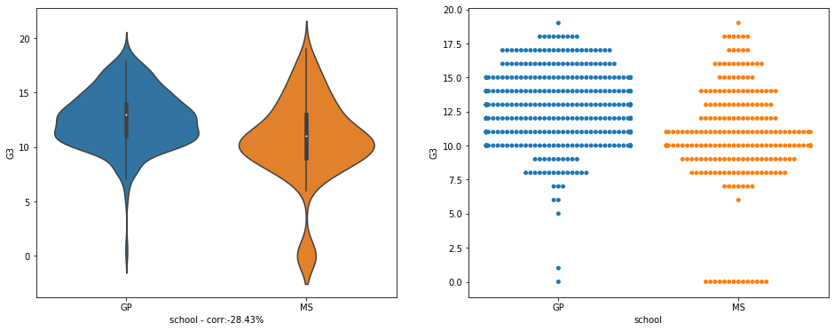
School and grades
Students study in Gabriel Pereira has higher grades than students in Mousinho da Silveira school

Slide 7
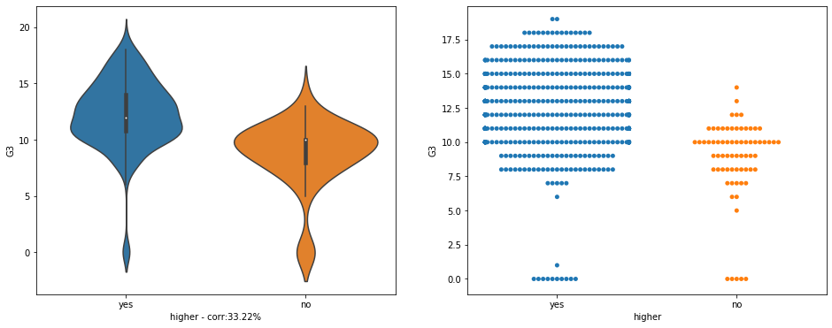
Willingness to learn
Students who want to take higher education have better performance

Slide 8
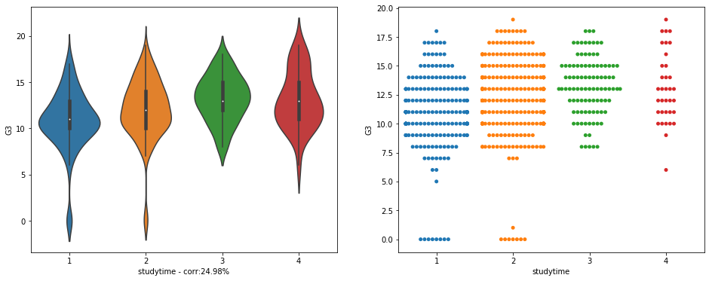
Study time
Students who study more time have better final grades

Slide 9
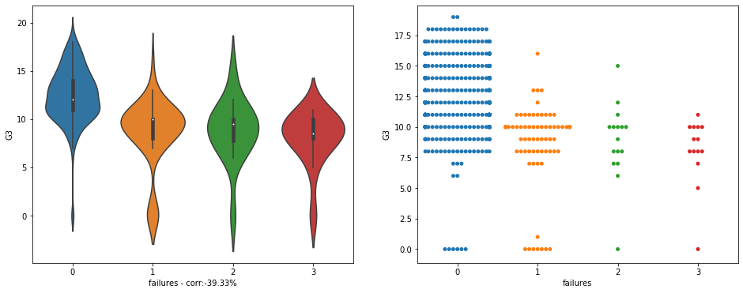
Failure in class
Students who failed less in class have better final grades

Slide 10
Willingness to learn
Students who want to take higher education have better performance

Slide 11
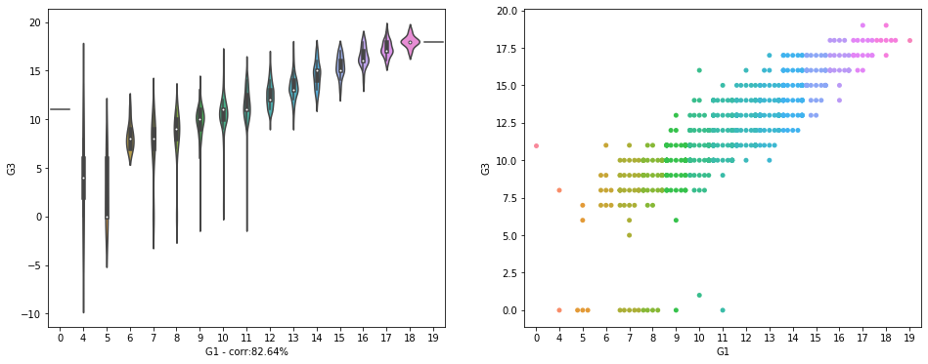
G1 with G3
G1 has a strong correlation with G3, which means the students grade will not change a lot during the 2 years study in the school.

Slide 12
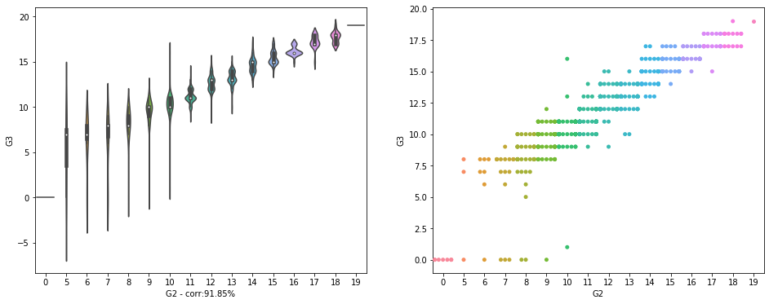
G2 with G3
G2 has a strong correlation with G3, and even higher correlation than G1, which means the students grade will not change too much during the 1 years study in the school.

Slide 13
G1, G2 with G3
We can have the conclusion that the students’ performance are more likely determine by their family, personal behavior or ability. The study in the two schools only keep their performance, but will not improve or downgrade too much.

Slide 14
Thanks

